Slide 1
Path2PPI
R package to predict protein-protein interactions in non-model organisms
Kyaw Hsu Thway

Slide 2
Path2PPI requires Bioconductor installation
if (!require("BiocManager", quietly = TRUE)) install.packages("BiocManager")
BiocManager::install("Path2PPI")
Data(ai)
## "human.ai.irefindex" "human.ai.proteins" "pa2human.ai.homologs"
## "pa2yeast.ai.homologs" "yeast.ai.irefindex" "yeast.ai.proteins"

Slide 3
Requires 3 types of files before prediction
Reference species proteins (belonging to a pathway of interest)
"human.ai.proteins
P42345 O75385 Q8IYT8 Q6PHR2 O75143
"MTOR" "ULK1" "ULK2" "ULK3" "ATG13”
Irefindex files (relevant protein-protein interaction files for each reference species)
Human.ai.irefindex
NCBI Blast + tool kit files where target species are ran against reference species proteins
Pa2human.ai.homologs

Slide 4
To predict PPI in a target species, we must add reference species proteins and their relevant interactions
ppi<- Path2PPI("Autophagy Induction","Podospora anserina","5145")
ppi <- addReference(ppi, "Homo sapiens", "9606", human.ai.proteins, human.ai.irefindex, pa2human.ai.homologs)
ppi <- addReference(ppi, "Saccharomyces cerevisiae (S288c)", "559292", yeast.ai.proteins, yeast.ai.irefindex, pa2yeast.ai.homologs)

Slide 5
Looking at processed referenced data
showReference(ppi)
Homo sapiens (TaxId: 9606)
---------------------------
5 proteins (0 not used)
894 interactions:
- 6 interactions have both interactors in protein list.
- 349 interactions have at least one interactor in protein list.
- 660 interactions in 102 protein complexes.
Saccharomyces cerevisiae (S288c) (TaxId: 559292)
-------------------------------------------------
7 proteins (0 not used)
2910 interactions:
- 15 interactions have both interactors in protein list.
- 834 interactions have at least one interactor in protein list.
- 2207 interactions in 102 protein complexes.

Slide 6
Predict PPI interactions by filtering through e value
Ppi<-predictPPI(ppi,h.range = c(1e-60,1e-20)
coordinates<-plot(ppi,return,coordinate = TRUE)
plot(ppi,multiple.edges = TRUE, vertices.coordinates=coordinates)

Slide 7
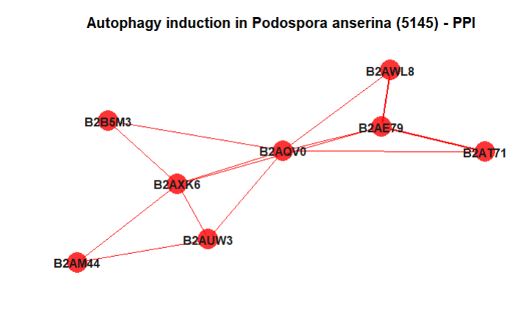
Predict PPI interactions by filtering through e value
coordinates<-plot(ppi,return,coordinate = TRUE)

Slide 8
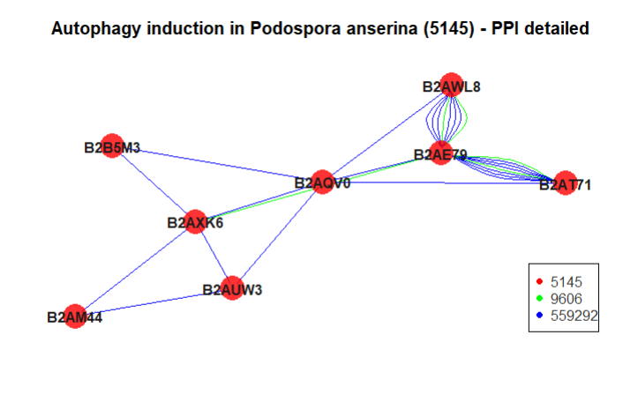
Predict PPI interactions by filtering through e value
plot(ppi,multiple.edges = TRUE, vertices.coordinates=coordinates)

